Slide 1

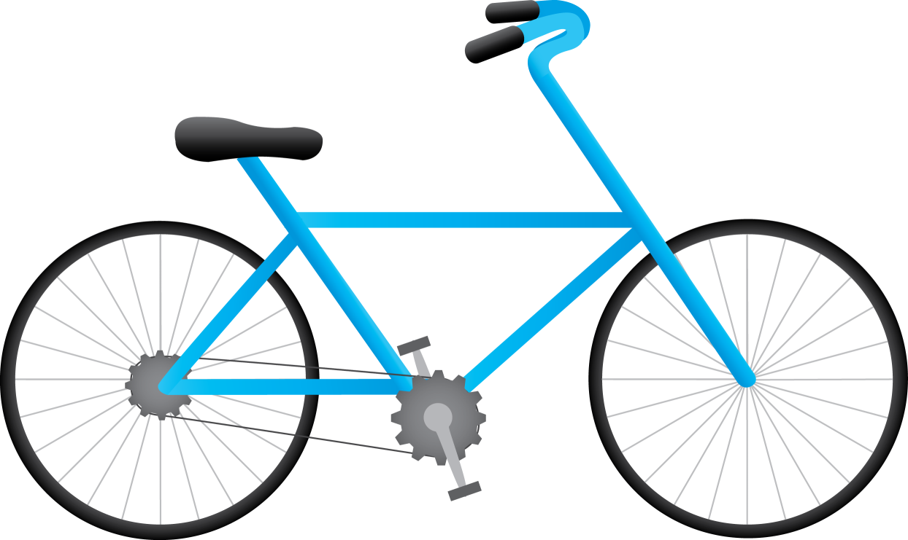
The A10 Corridor Cycle Campaign

Slide 2
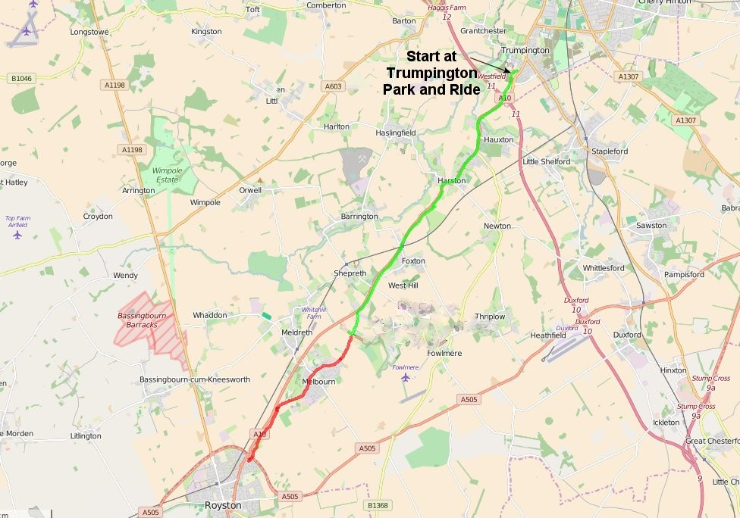
A10 Cycle Path
We expect to have 8 miles of path
completed by April 2017

Slide 3
What we did at the start
1. It was initiated by us the local people
2. We started a campaign with cyclists from along the length of the route.
3. We recognised we could not get funding for the whole route from available
sources so went for a small orphan section on the live horse and you will grow
grass principle. We got lucky
4. We approached a wide range of sponsors and helpers but still kept Cambs
County Council as the core design provider.
5. We used the various strengths in our team. We obtained significant publicity.
We built our own web site. We crossed the County boundary by using the
Cambridge and Peterborough Local Enterprise Partnership. We obtained
support from over100 local businesses

Slide 4
The A10 Cycle Path
There was an obvious need for a cycle path
The A10 is a very busy highway
The A10 links Royston to Cambridge
There are two big villages along the route
The existing paths were of a very low standard
The funds needed were about £7.5M
A good cycleway would fit Cambs C.C. policy

Slide 5
Support for the scheme
Susan was a key person driving support
Sustrans gave us vital advice
Cambs C.C designed various sections
Cambs C.C. upgrade the path between Hauxton Mill and Harston
Herts C.C. agreed to join the Campaign
Royston cyclists joined and were highly supportive
Herts MP Oliver Heald was contacted
We ran our Awareness Rides to gain publicity

Slide 6
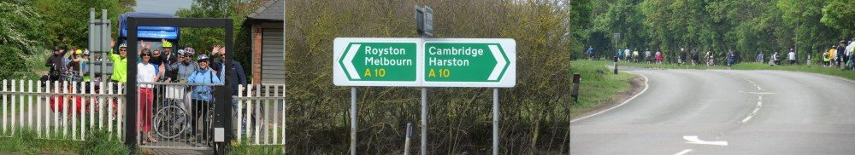
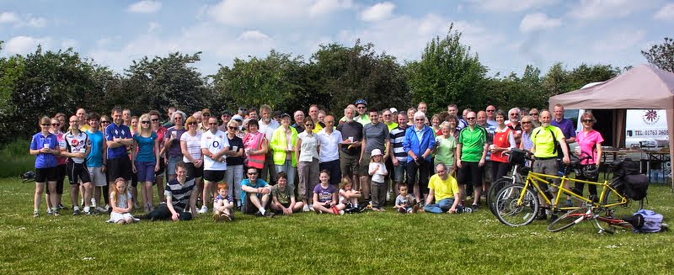
A10 Corridor Cycling Campaign
A website was started
Link https://a10corridorcycle.com
To publicise the Campaign

Slide 7
A10 Cycle Path
We expect to have 8 miles of path
completed by April 2017

